Slide 1

ASANTE AKIM CENTRAL MUNICIPAL ASSEMBLY
2022 COMPOSITE BUDGET HEARING
15TH OCTOBER, 2021
PRESENTATION BY:
HON. ROBERT KWAKYE [MCE ]

Slide 2
INTRODUCTION OF THE MUNICIPAL ASSEMBLY
Establishment of the District
THE ASANTE AKIM CENTRAL MUNICIPALITY is one of the forty-Three (43) Districts in the Ashanti Region. It was created by Legislative Instrument (L.I) 2056 in 2012 and it has Konongo – Odumasi as its twin Capital Town.
For the purpose of decentralization and local government representation, the Municipality has one (1) electoral constituency for parliamentary representation, Twenty-five (25) electoral areas for Municipal Assembly representation and three (3) zonal councils (Konongo-Odumasi, Dwease-Praaso and Owereagya councils).
Location and Size
The Asante Akim Central Municipal Assembly is located in the eastern part of the Ashanti Region. It shares boundaries with Asante Akim North Municipal at the North, Juaben Municipal and Sekyere East at the West, Asante Akim South at the East and South. The land size of the Municipality is 300 square kilometers (km2) forming 1.6 % of the total land area of Ashanti region.

Slide 3
Population
The population of the Municipality, according to the 2010 Population and Housing Census is 71,508. This comprises of 33,942 males (47.5%) and 37,566 (52.5%) females. With a growth rate of 2.7%, the population of the Municipality for the year 2020 and 2021 is estimated to be 93, 673 and 96,237 respectively

Slide 4
MUNICIPAL ECONOMY
Agriculture
Agriculture is the mainstay of the local economy, produces food and vegetable crops such as cassava, cereals, tomatoes, and garden eggs.
Cash crops such as cocoa, oil palm, and oranges are extensively cultivated in the municipality.
With the increasing population, there is likely to be pressure on arable land.
Snail and mushroom farming, bee keeping are the adopted alternative agricultural livelihoods in some of the communities.
Livestock is mainly kept on free range basis with cattle and poultry kept for commercial purposes.
Investors also take advantage of the enabling environment in the animal husbandry sector.
Notes:
6

Slide 5
Education
The Directorate seeks to provide quality education to children within the school going age in the municipality irrespective of gender, language and Geographical location.
To achieve this vision, the office has been collaborating with SMCs parents Development Partners, NGO, Traditional Authorities, Religious organizations, Financial Institutions and above all the Municipal Assembly.
The municipality has both basic and secondary schools.
In all there are 250 schools in the municipality. Breakdown are as follows: Eighty-Nine (89) Pre-Schools, Eighty-Nine (89) Primary Schools, Sixty-Six (66)Junior High Schools, Five (5) Senior High Schools and One (1) Technical/vocational school.

Slide 6
Health
The Municipality has only one public hospital located in the Municipal capital, Konongo – Odumasi.
This facility serves residents within the Municipality and beyond.
There is also one privately-owned hospital and three privately-owned heath centres in Konongo to assist in providing health care services.
There are Five health Centres in the municipality located in Dwease, Odumase, Patriensa, Nyabo and Praaso, to attend to minor cases and illnesses. Services provided at such facilities include, out-patient, ante-natal, in-patient and dispensary.
Furthermore, the municipality has Five (5) Community-Based Health Planning Services (CHPS) compounds. Located at Kramokrom, Boatengkrom, Kyekyewere, Kyekyebiase and Obenimase.

Slide 7
Top 10 Causes of Admissions half year 2021
Source: G.H.S.

Slide 8
Covid – 19 Pandemic 2020 to date
Total sample taken – 818
Number positive – 340
Recoveries – 326
Deaths – 1
Active cases - 13
Source: G.H.S.

Slide 9
Water
The main source of water for domestic and commercial uses are borehole and pipe born water.
The dam that serves the three Asante Akim assemblies is located in Odumasi-Agyaerago.
According to the 2010 Population and Housing Census District Analytical Report, about Forty Nine (49%) of the rural household depend on borehole water for drinking, cooking and other household chores.
Other sources include rain water, dug well, rivers, streams etc.

Slide 10
Road Network
The Municipality is located along the Accra-Kumasi highway and currently has about 16.5km of asphalted Class I roads, 27km of Class II, and about 134km of Class III.
Road networks leading to the communities are in bad state except few ones that have been tarred.
The poor quality of roads directly correspond to high transport costs particularly with the transport of agricultural produce from the rural areas.

Slide 11
Sanitation
According to 2010 Population and Housing Census, the toilet facility mostly used by household in the municipality is public toilet, (WC,KVIP Pit).
This constitutes 34.2% of the toilet facility. However, appreciable number of the population in the municipality have toilet facilities in their homes. KVIP, Pit latrine and Water Closets constitute 25.7%, 20.7% and 11.2% of the toilet facilities in the municipality respectively. Open defecation and other also constitute 7.6%.
Also, waste management is another sanitation issue confronting the municipality. The commonest method of waste disposal are open space and public containers.
Whereas open space is predominantly practiced in the rural areas, public containers is practiced in the urban areas. Other form of waste disposal includes open burning, indiscriminate dumping and refuse pit.

Slide 12
Trade and commerce
Trade and commerce in the municipality is very brisk due to its nodal location.
The municipal capital serves as the commercial hub of the municipality.
They also contribute significantly to the Assembly’s Internally Generated Fund (IGF).
Market
There are six (6) market centres across the municipality. These markets provide avenues for transactions in the buying and selling of both agricultural and industrial goods.
The most vibrant of these market is the Konongo market with Tuesday as it main market day and Friday as a supportive market day.

Slide 13
 | NAME | LOCATION | MARKET DAYS
1 | Konongo Market | Konongo | Tuesdays/Fridays
2 | Odumasi Market | Odumasi | Thursdays
3 | Dwease Market | Dwease | Wednesdays
4 | Praaso Market | Praaso | Tuesdays
5 | Patriensa Market | Patriensa | Daily market
6 | Odumasi Zongo Market | Odumasi | Daily

Slide 14
      Industrial activity
There are a number of industrial activities that go on in the municipality including:
  Agro-based industrial activities such as palm oil and gari processing.
  Other industrial activities such as steel production, wood processing and batik making.
Mining and quarrying
The Municipality’s gold deposits have made it one of the notable gold mining areas in the region.
Large scale gold mining is done by one company with its main mining site at Konongo with another site at the Obenimase area.
Apart from the company, there are a number of small scale miners in the municipality.
The Dwease–Praaso area which is rich granite has potential for large scale quarrying.

Slide 15
Energy
Energy plays a significant role in households’ day-to-day activities. The main source of energy in the municipality is electricity which is tapped from the national grid.
According to the 2010 Population and Housing Census 71.5% of the population in the municipality have access to electricity in their homes while 10.4% depend on kerosene lamp.
Furthermore, 16.7% of the residents rely on battery-powered flashlights and torches with 0.4% depending on diesel powered generators.
According to 2010 population and housing census, 38.7% of the residents use firewood for cooking while 36.1% use charcoal. Nevertheless, an appreciable number of residents rely on other efficient energy sources such as gas (15.6%), electricity (0.3%) and kerosene (0.4%).

Slide 16
4.0 KEY ISSUES/CHALLENGES
The following are the key issues of the Municipal Assembly:
Limited business development skills
Low agricultural Productivity
High Post-Harvest losses
Poor road surface condition and Inadequate drains along roads.
Inadequate resources for monitoring of educational programmes
Inadequate health infrastructure
High incidence of malaria cases
Insufficient mobilization of internally generated funds by the Assembly

Slide 17
VISION
Asante Akim Central Municipal Assembly aspires to become a world class organization providing client focused and customer friendly services delivered by a peak performing staff in partnership with stakeholders
GOAL/MISSION STATEMENT
The Asante Akim Central Municipal Assembly exists to ensure a better standard of living by providing the right leadership, in the development of infrastructure and delivery of socio-economic services, through stakeholder participation with equal opportunity for all

Slide 18
CORE FUNCTIONS OF THE ASSEMBLY
The core functions of the municipality includes the following:
Formulation and execution of plans, programs and strategies for the overall development of the Municipality
Provision of infrastructure e.g. schools, clinics, etc.
Formulation and approval of composite budget and Making of bye-laws.
Levying and collection of taxes, rates, fees, etc. to generate revenue.
Promotion of justice by ensuring ready access to the courts in the Municipality.
Maintenance of security and public safety in the Municipality
Ensuring proper sanitation management in the Municipality.
Preparation of land use plans (structure and local plans) to direct and guide the growth and sustainable development of human settlements in the Municipal area.
The promotion and protection of the rights of children.
Training of women, Artisans and Medium/Small scale entrepreneurs’ in business development skills and Provision of extensions service to farmers.
Assist in the formulation and implementation of policies on Education and Health in the Municipality within the framework of National Policies and guidelines.
Provision of layout for buildings to improve housing layout and settlement.

Slide 19
ASANTE AKIM CENTRAL MUNICIPAL ASSEMBLY’S ADOPTED POLICY OBJECTIVES
Deepen political and administrative decentralization
Strengthen domestic resource mobilization.
Ensure free, equitable and quality education for all by 2030
Supplement and strengthen local communities in improve water and sanitation
Achieve universal health coverage, including financial risk protection access to quality health-care service
Improve production efficiency and yield
Enhance inclusive urbanization & capacity for settlement planning

Slide 20
ASANTE AKIM CENTRAL MUNICIPAL ASSEMBLY’S ADOPTED POLICY OBJECTIVES (Con’t)
Implement appropriate Social Protection System & measures
Ensure all learners acquire knowledge & skills, to promote Sustainable development
Reduce vulnerability to climate-related events and disasters
Improve efficiency & effectiveness of road transportation infrastructure & service
Provide legal identity including birth registration
Improve human capital development and management
Achieve income growth of bottom 40% of population above national average.

Slide 21
FINANCIAL PERFORMANCE-REVENUE
REVENUE PERFORMANCE- IGF ONLY
ITEM | 2019 |  | 2020 |  | 2021 |  | % at July, 2021
 | Budget | Actual | Budget | Actual | Budget | Actual as at July
Basic Rate | 5,000.00 | 1,250.00 | 5,000.00 | 439.00 | 3,000.00 | 1,399.00 | 0.26
Property Rate | 273,475.21 | 216,534.76 | 270,905.21 | 245,934.17 | 292,465.74 | 78,409.87 | 14.62
Fees | 459,120.16 | 186,338.93 | 567,500.00 | 288,482.00 | 567,500.00 | 177,871.00 | 33.18
Fines | 116,400.00 | 249,323.66 | 29,440.00 | 7,581.00 | 29,440.00 | 7,150.00 | 1.33
Licenses | 252,000.00 | 18,255.00 | 308,675.00 | 187,887.10 | 315,675.00 | 98,096.00 | 18.30
Land | 162,850.00 | 163,391.00 | 162,600.00 | 168,187.00 | 163,600 | 112,962.00 | 21.07
Stool Lands | 25,000 | 15,000.00 | 20,000.00 | 11,000.00 | 20,000.00 | 11,800.00 | 2.20
Rent | 76,190.00 | 18,255.00 | 77,870.00 | 82,143.00 | 77,870.00 | 48,456.00 | 9.04
Miscellaneous | 3,000.00 | 1,994.49 | 1,000.00 | 0 | 500 | 0 | -
TOTAL | 1,277,860.21 | 1,087,566.22 | 1,462,990.21 | 991,653.27 | 1,470,050.74 | 536,143.87

Slide 22
FINANCIAL PERFORMANCE-EXPENDITURE
EXPENDITURE PERFORMANCE (ALL DEPARTMENTS) GOG ONLY
Expenditure | 2019 |  | 2020 |  | 2021 |  | % performance at July, 2021
 | Budget | Actual | Budget | Actual | Budget | Actual as at July
Compensation | 3,267,450.00 | 2,265,413.28 | 2,795,893.53 | 2,265,413.28 | 3,092,672.25 | 1,321,491.08 | 42.73
Goods and Services | 110,047.20 | 13,349.83 | 119,856.66 | 98,630.14 | 200,000.00 | 73,605.82 | 36.8
Assets | 0 | 0 | 0 | 0 | 0 | 0 | 0
Total | 3,377,497.20 | 2,278,763.11 | 2,915,750.19 | 2,364,043.42 | 3,292,672.25 | 1,395,096.90 | 79.53

Slide 23
FINANCIAL PERFORMANCE-REVENUE
REVENUE PERFORMANCE- ALL REVENUE SOURCES
ITEM | 2019 |  | 2020 |  | 2021 |  | % perfo as at July, 2021
 | Budget | Actual | Budget | Actual | Budget | Actual as at July
IGF | 1,420,480.21 | 1,087,566.22 | 1,442,990.21 | 991,653.27 | 1,470,050.74 | 536,143.87 | 36.47
Compensation Transfer | 3,267,450.00 | 2,265,413.28 | 2,795,893.53 | 2,265,413.28 | 3,092,672.25 | 1,321,491.08 | 42.73
Goods and Services transfer | 110,047.20 | 13,349.20 | 119,856.66 | 94,026.35 | 200,000.00 | 73,605.82 | 36.80
DACF | 4,653,368.40 | 2,375,537.14 | 5,052,741.93 | 2,826,495.13 | 7,483,669.95 | 151,006.99 | 2.02
DDF | 976,219.00 | 776,808.27 | 736,114.72 | 401,485.90 | 1,531,100.46 | 1,118,096.00 | 73.03
Other donor (mag) | 172,948.68 | 186,250.00 | 270,575.86 | 150,226.53 | 291,107.76 | 49,570.15 | 17.03
Total | 10,600,513.49 | 6,704,924.74 | 10,418,172.91 | 6,729,300.46 | 14,068,601.16 | 3,249,913.91 | 23.10

Slide 24
FINANCIAL PERFORMANCE-EXPENDITURE
EXPENDITURE PERFORMANCE (ALL DEPARTMENTS) IGF ONLY
Expenditure | 2019 |  | 2020 |  | 2021 |  | % performance at July, 2021
 | Budget | Actual | Budget | Actual | Budget | Actual as at July
Compensation | 97,000.00 | 95,632.30 | 105,204.53 | 63,618.69 | 123,680.74 | 54,132.02 | 9.89
Goods and Services | 1,103,210.21 | 941,433.92 | 804,918.75 | 551,972.36 | 1,176,370.00 | 478,301.33 | 87.43
Assets | 220,270.00 | 50,500.00 | 288,598.04 | 77,417.56 | 170,000.00 | 14,662.95 | 2.68
TOTAL | 1,420,480.21 | 1,087,566.22 | 1,198,721.32 | 693,008.61 | 1,470,050.74 | 547,096.30

Slide 25
FINANCIAL PERFORMANCE-EXPENDITURE
EXPENDITURE PERFORMANCE (ALL DEPARTMENTS) ALL FUNDING SOURCES
Expenditure | 2019 |  | 2020 |  | 2021
 | Budget | Actual | Budget | Actual | Budget | Actual as at July. | % age Performance (as at July. 2021)
Compensation | 4,687,930.21 | 3,352,979.50 | 4,238,883.74 | 3,513,895.53 | 3,496,352.99 | 1,375,623.10 | 39.34
Goods and Services | 3,968,548.87 | 2,176,549.90 | 3,524,765.27 | 2,044,199.64 | 5,687,848.19 | 532,989.58 | 9.37
Assets | 1,944,034.43 | 1,175,395.34 | 2,654,523.90 | 1,171,205.29 | 4,884,399.98 | 751,669.79 | 15.39
Total | 10,600,513.51 | 6,704,924.74 | 10,418,172.91 | 6,729,300.46 | 14,068,601.16 | 2,660,282.47 | 18.91

Slide 26
NON FINANCIAL PERFORMANCE BY PROGRAMMES

Slide 27
KEY ACHIEVEMENTS (2021)
Completed 3No. toilets facilities in Kramokrom, Praaso and Agareago.
Constructed Cassava Processing Factory (1D1F Initiative) at Konongo low cost
Provided 1No. 50KVA pole-mounted transformer for the cassava factory at Konongo - Low cost.
Completing 1 No. 3 unit classroom block with office, store, staff common room with 6 seater squat W/C toilet with mechanized borehole and furniture at Ohenekwanta. 75% completed

Slide 28
KEY ACHIEVEMENTS (2021). Cont….
Drilled and mechanized 6 No. boreholes at
Bimma, Dwease, Adumkrom, Obenimase, Patriensa and
Odumasi extension (IGF). 70% completed
Drilled and Mechanized of 4 No. borehole at Odumasi market, konongo market & lorry station, kyekyewere town centre (DDF). 68% completed
Constructed 1 No. 11 Unit Market Shed with Urinal at
Kyekyebiase. 65% Completed
Constructed 1No. number ambulance service unit at Konongo Odumasi.

Slide 29
KEY ACHIEVEMENTS (2021). Cont….
Current champions of zonal and super zonal independent
anniversary debate of the 2nd cycle.
Pupils furniture deficit ratio improved from 4:1 to 3:1 at
the basic level (Kg, Primary and JHS).
Pupils Reading ability rate has increased from 50.4% to
65% due to the introduction of early morning reading at
the basic level.
Distributed 10,000 oil palm seedlings to 197 farmers
amounting to Ghc 100,000.
Provided logistics to Agric department by MAG.
Increased in rice production from 3.5 metric tonnes per
hectare to 4.02 metric tonnes per hectare.

Slide 30
KEY ACHIEVEMENTS (2021). Cont….
Distributed rice inputs to 2 women groups.
ITEMS | QUANTITY
Net 12 | 6 each
Insecticide | 2 Liters
Nicopin | 2 Liters
40KG Rice | 8 Pieces
NPK 25Kg
Urea | 4 Bags
Glyphosape | 2 Litres

Slide 31
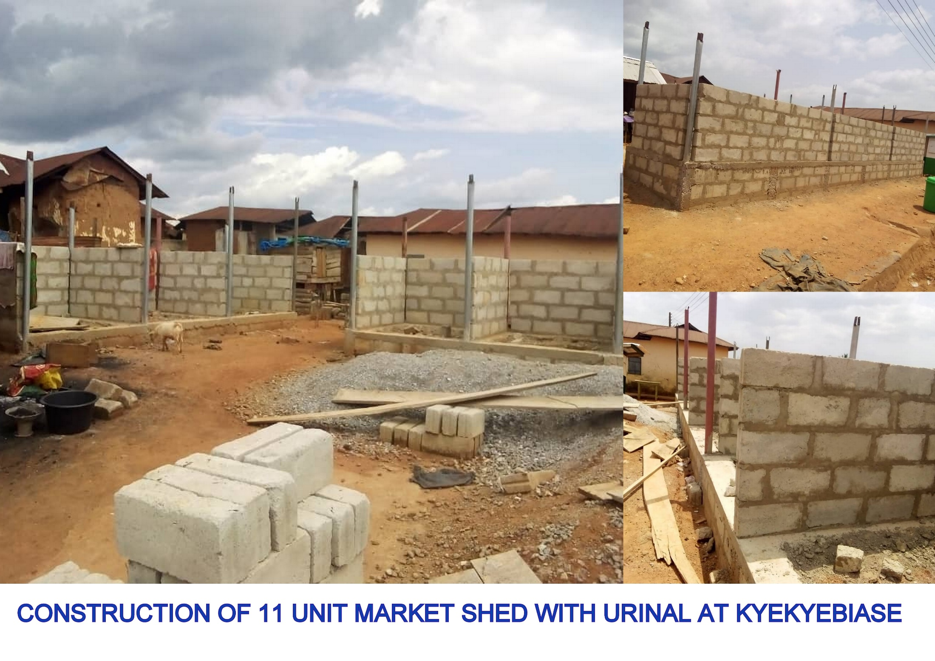
2021 KEY ACHIEVEMENTS
PROGRAMME / PROJECTS
11. Current champions of zonal and super zonal independent
anniversary debate of the 2nd cycle.
12. Pupils furnisher deficit ratio improved from 4:1 to 3:1 at
the basic level (Kg, Primary and JHS).
13. Pupils Reading ability rate has increased from 50.4% to
65% due to the introduction of early morning reading at
the basic level.
14. Distributed 10,000 oil palm seedlings to 197 farmers
amounting to Ghc 100,000.
15. Distributed rice inputs 2 women groups.
16. Provided logistics to Agric department by MAG.
17. Increased in rice production from 3.5 metric tonnes per
hectare to 4.02 metric tonnes per hectare.

Slide 32
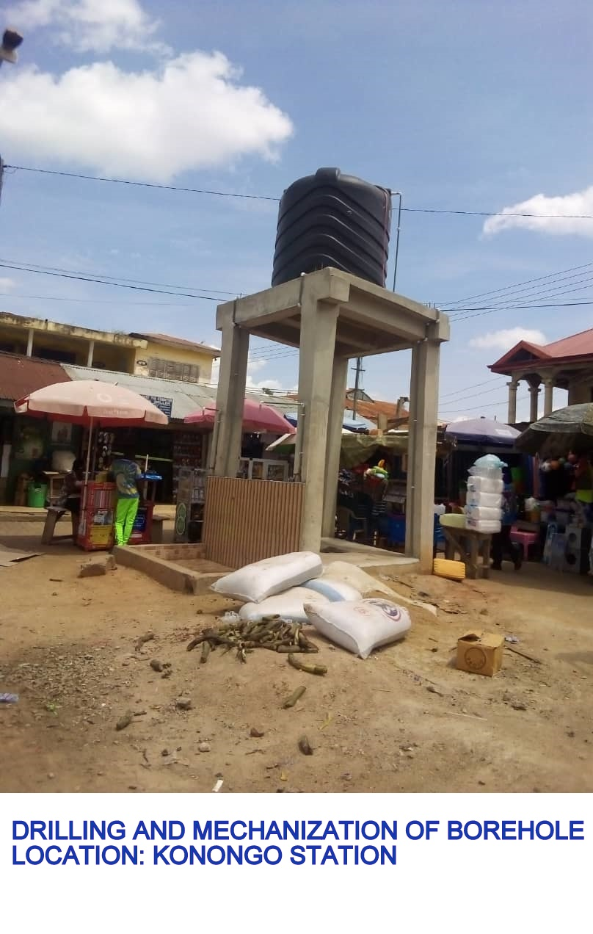
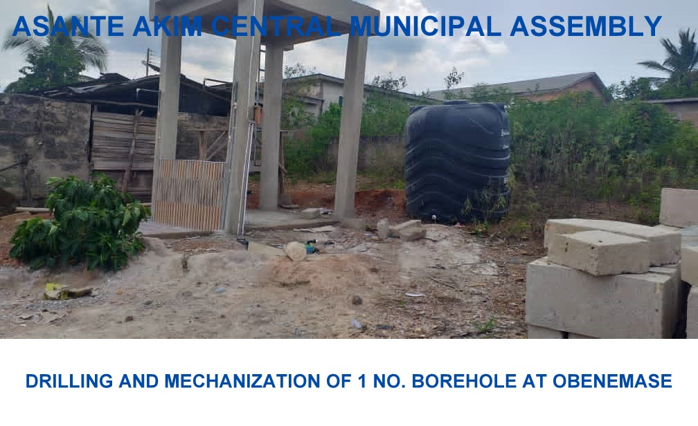

Slide 33
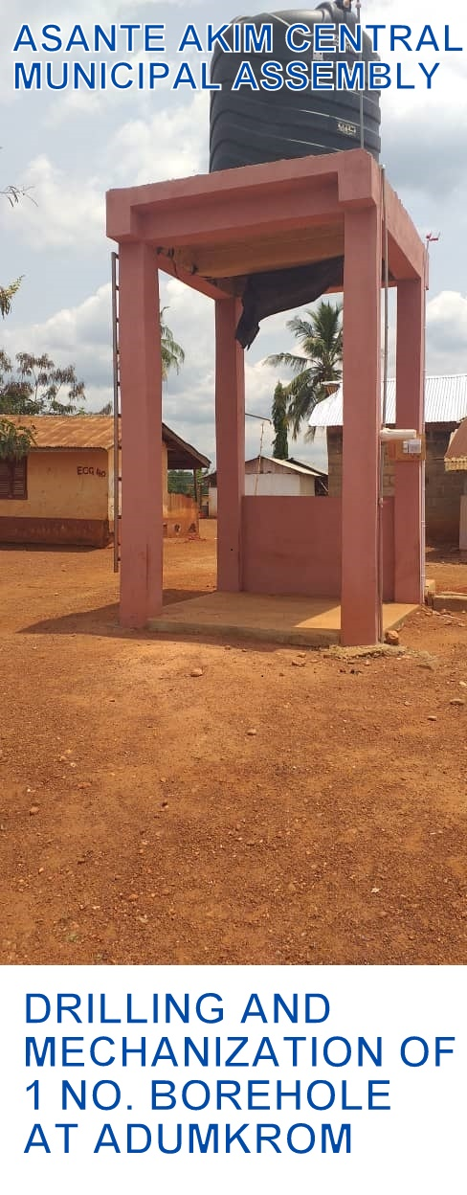
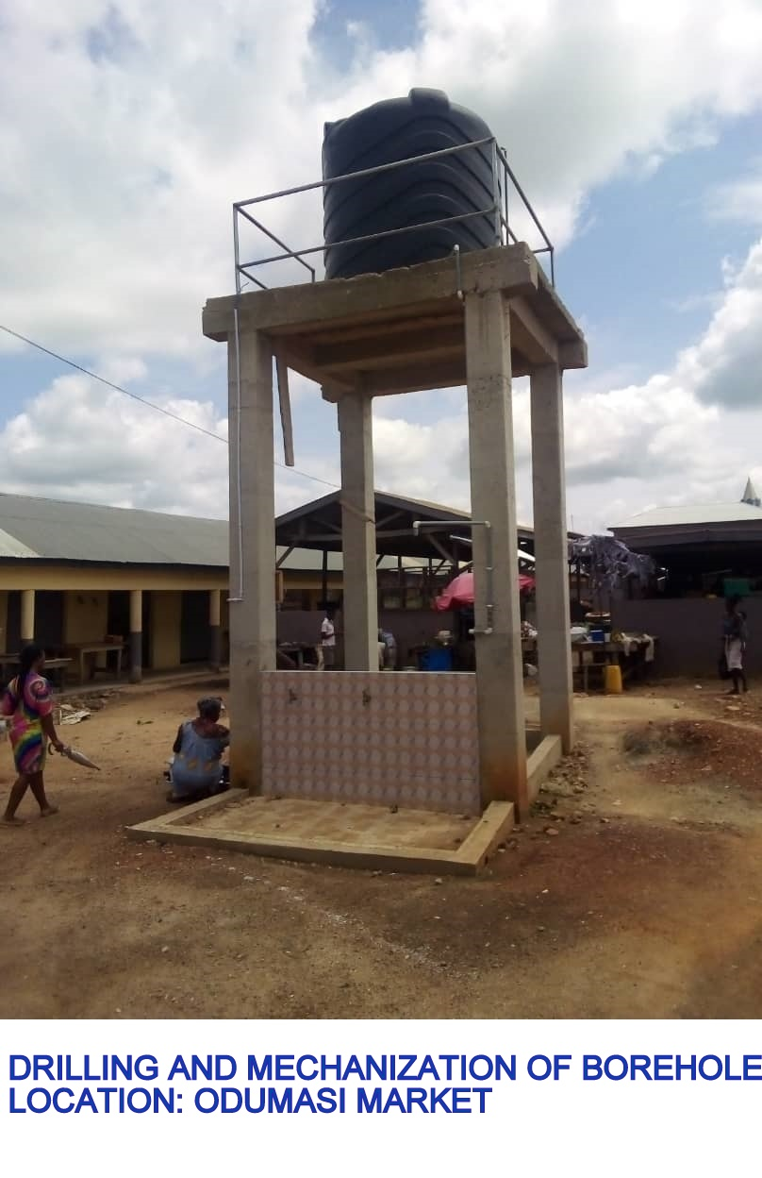

Slide 34
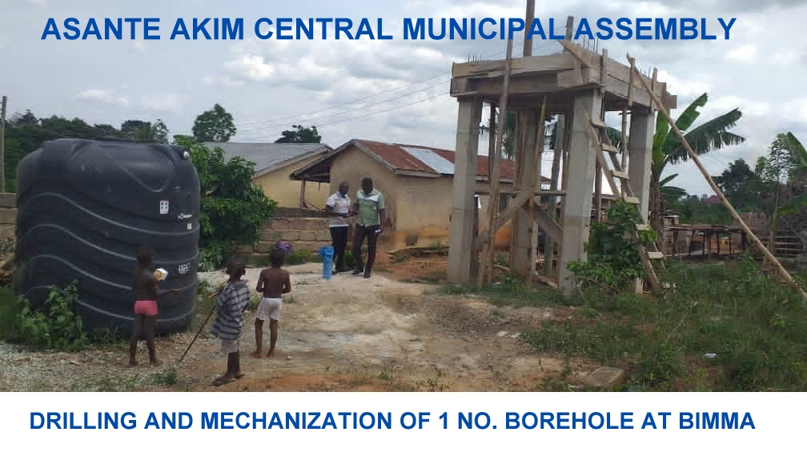
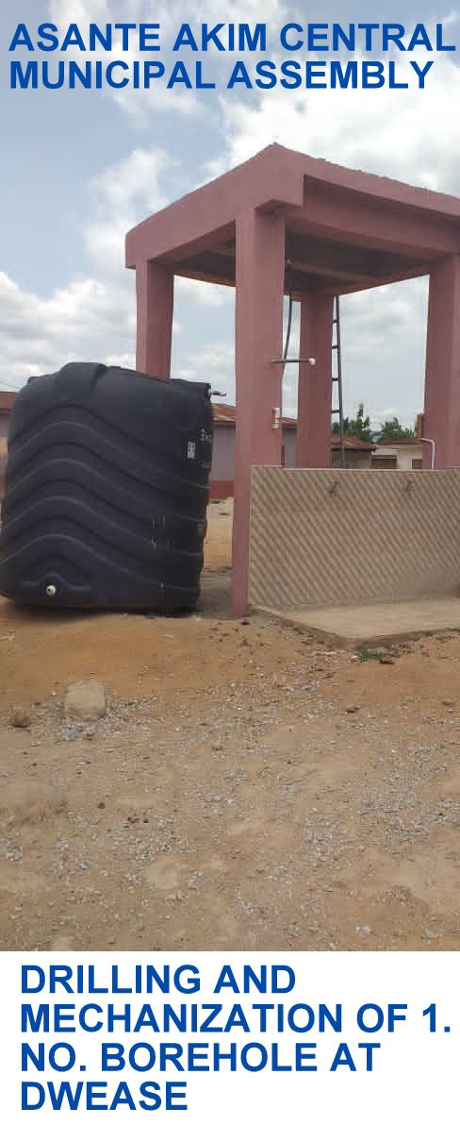

Slide 35
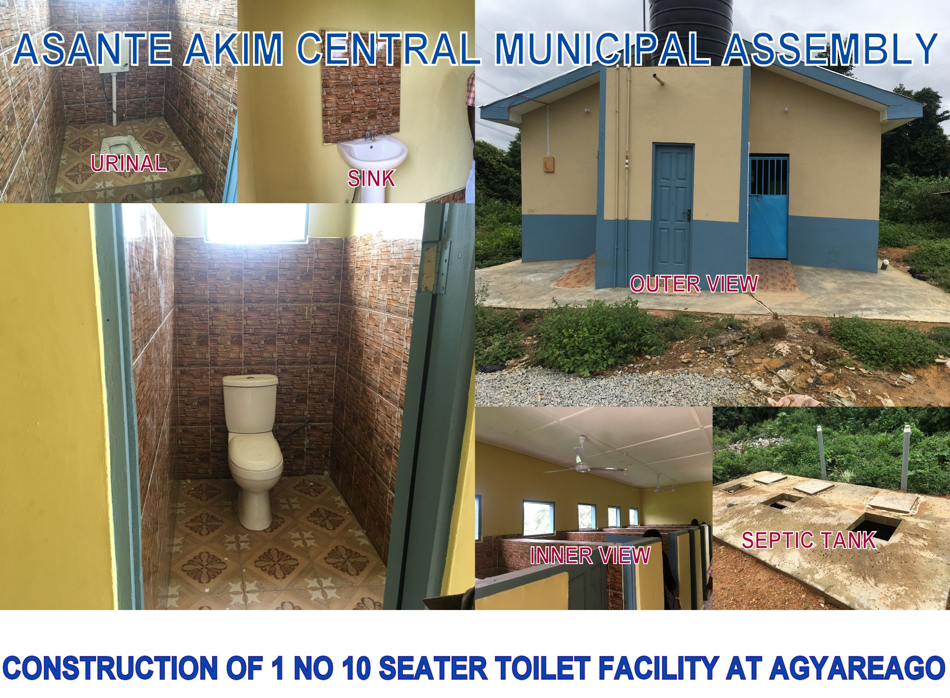

Slide 36
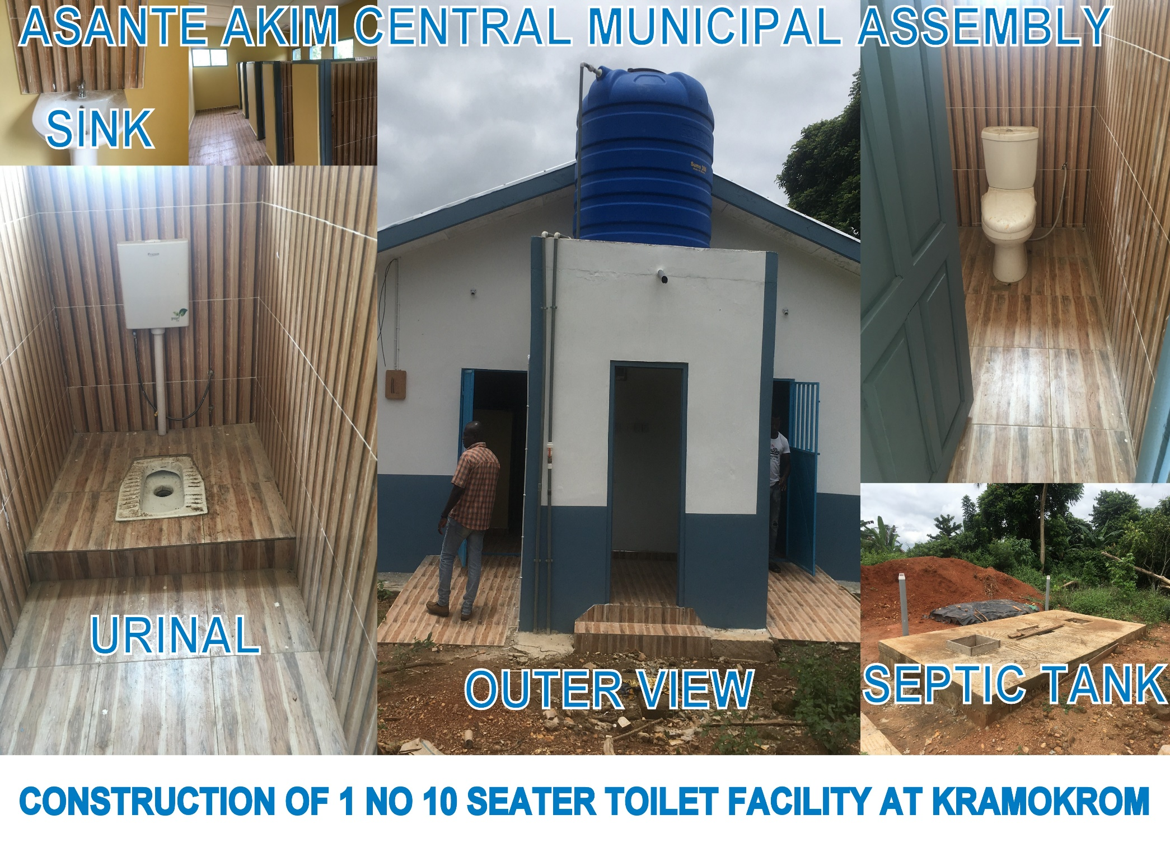

Slide 37
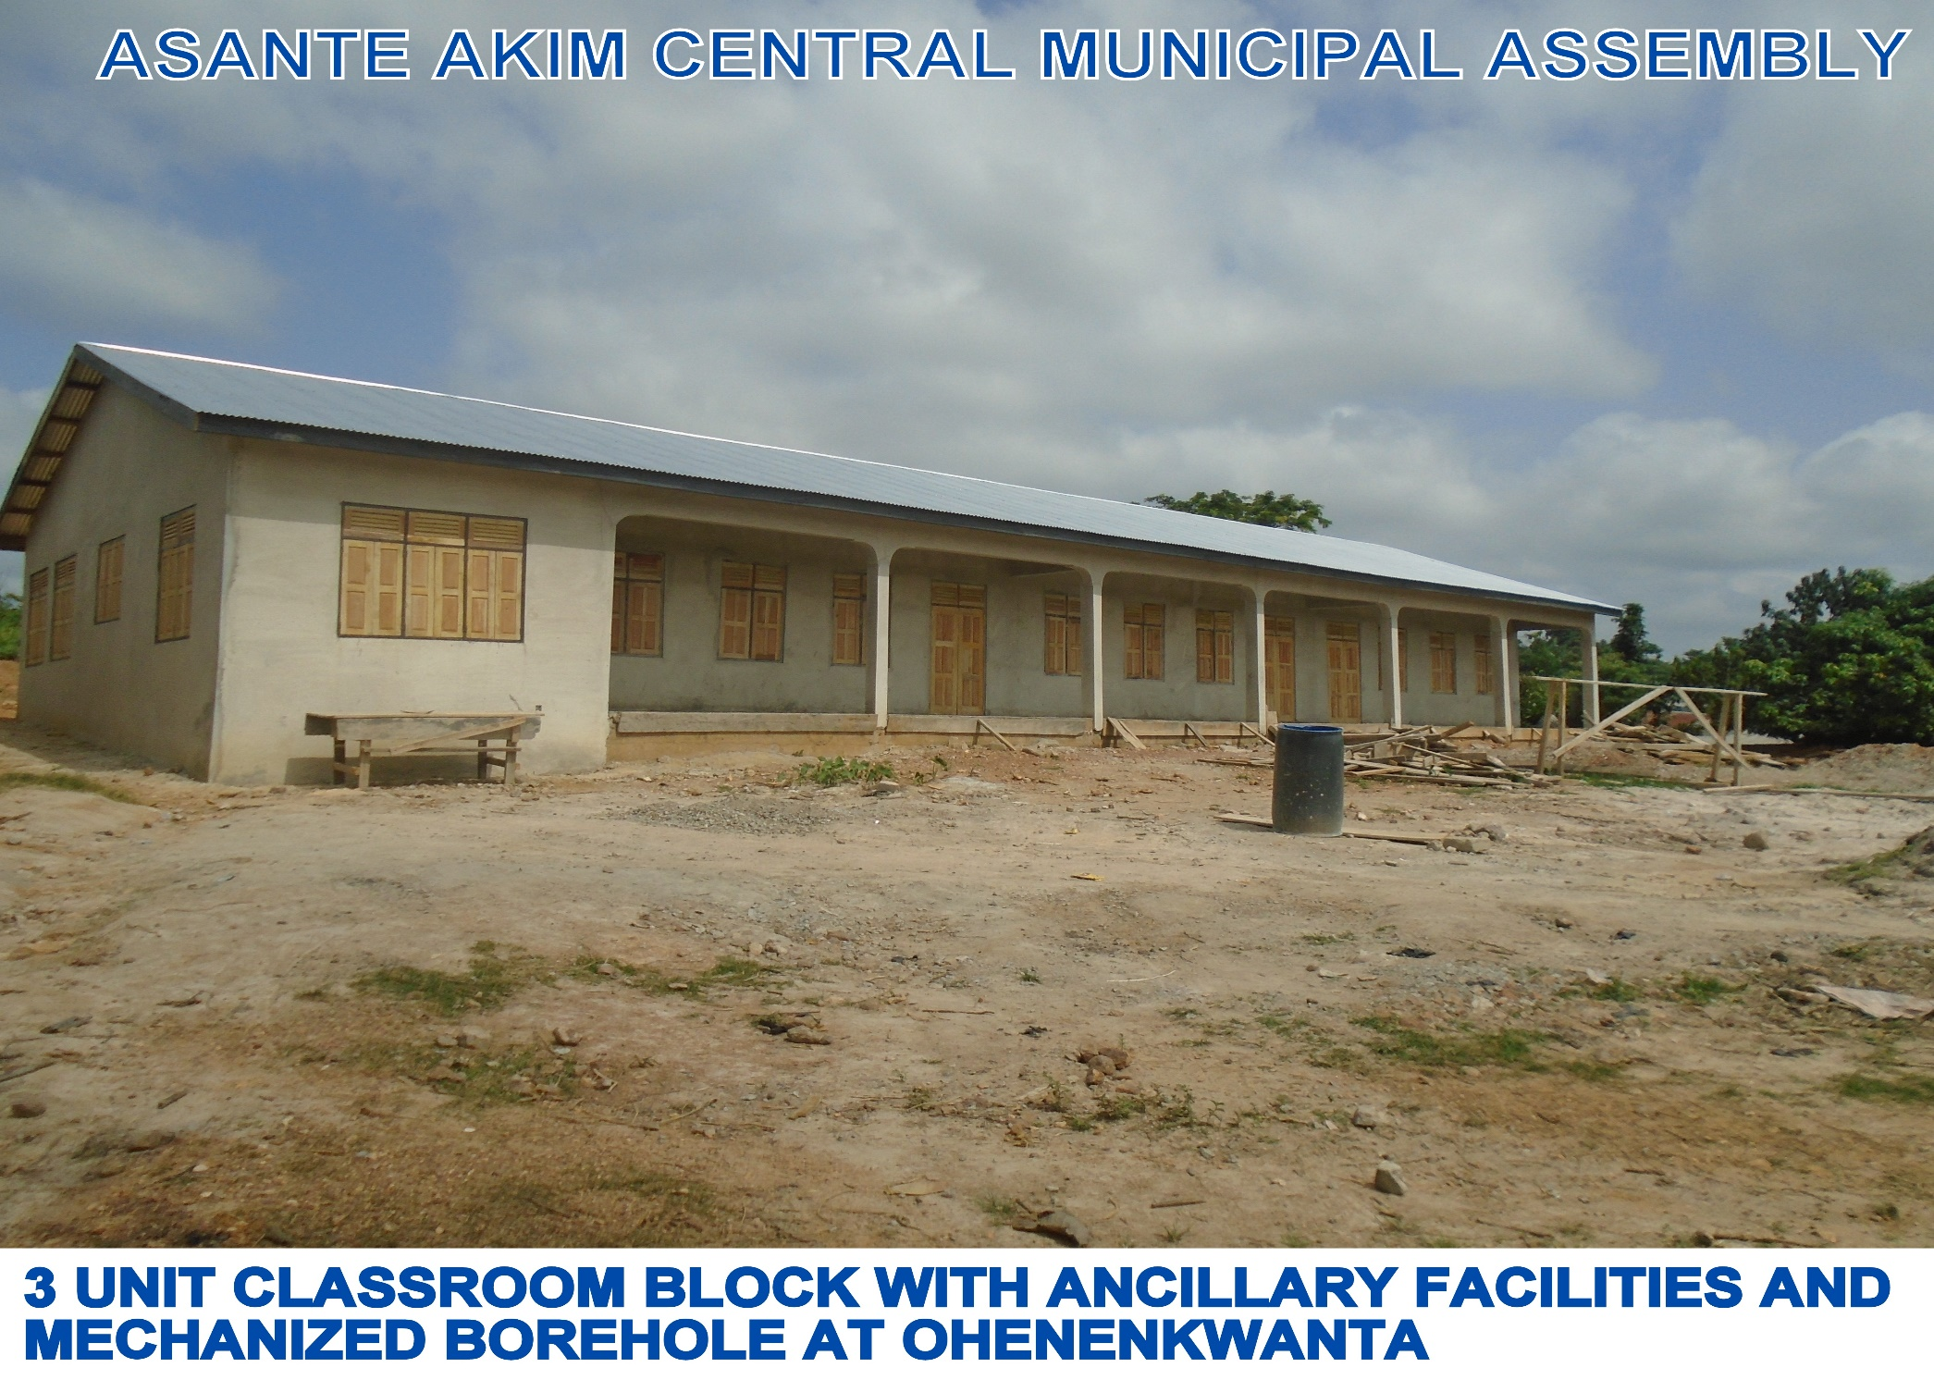

Slide 38
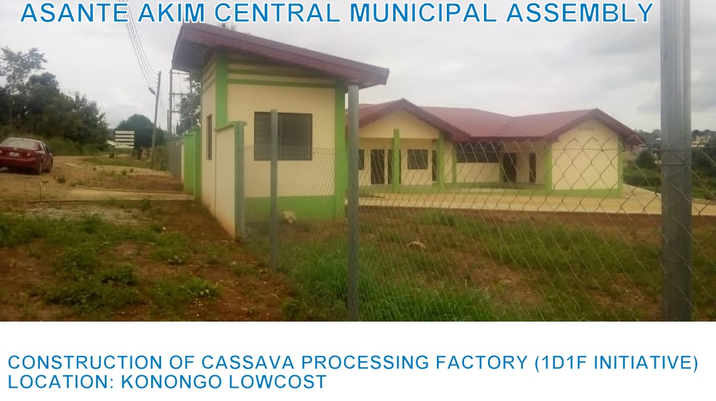

Slide 39
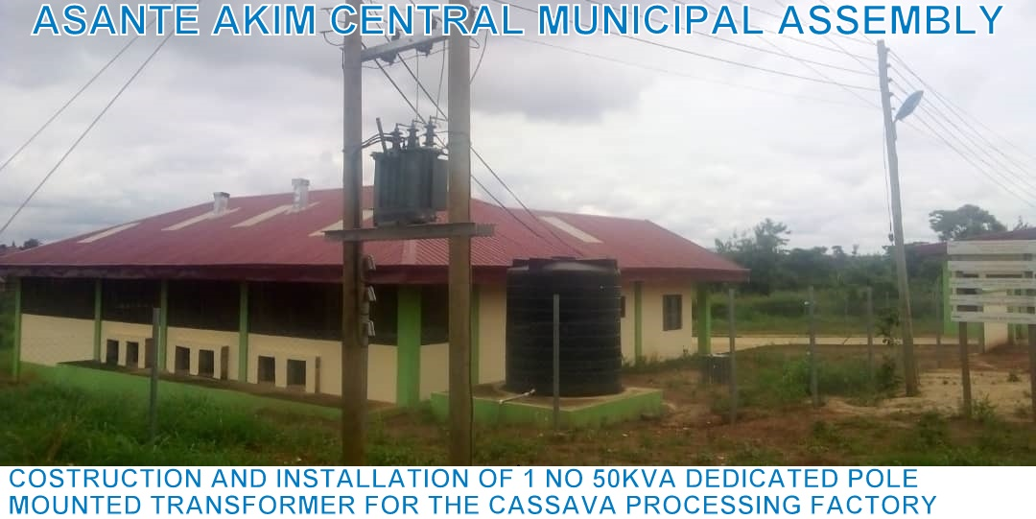

Slide 40
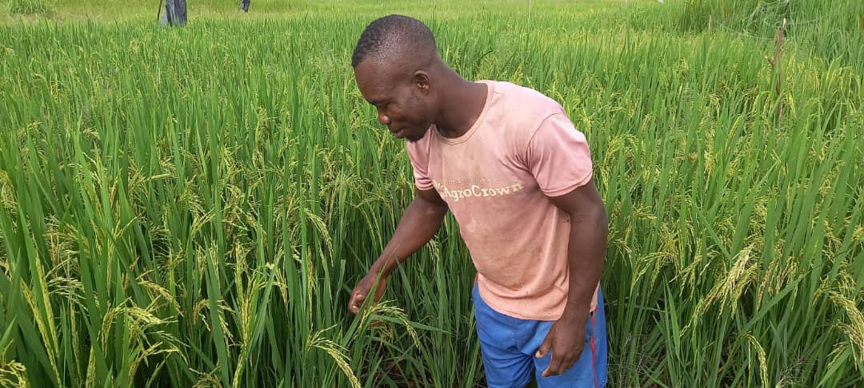
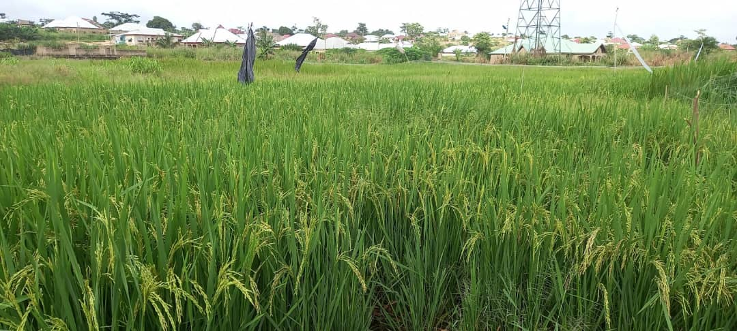

Slide 41
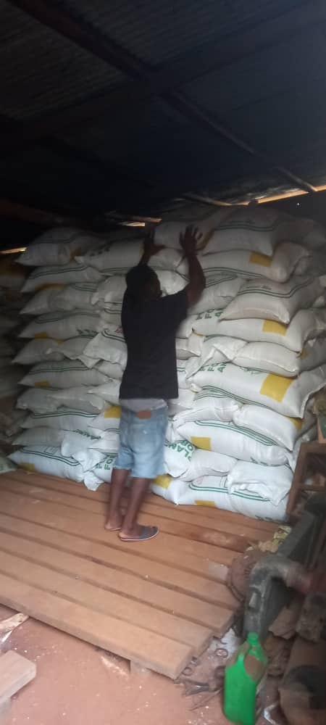
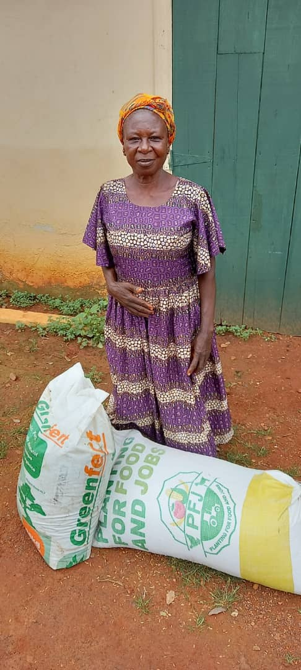

Slide 42
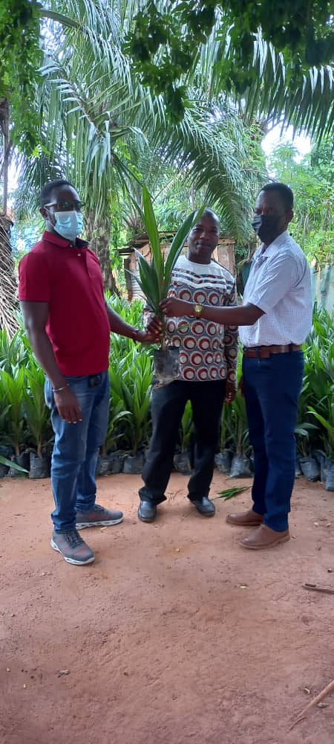
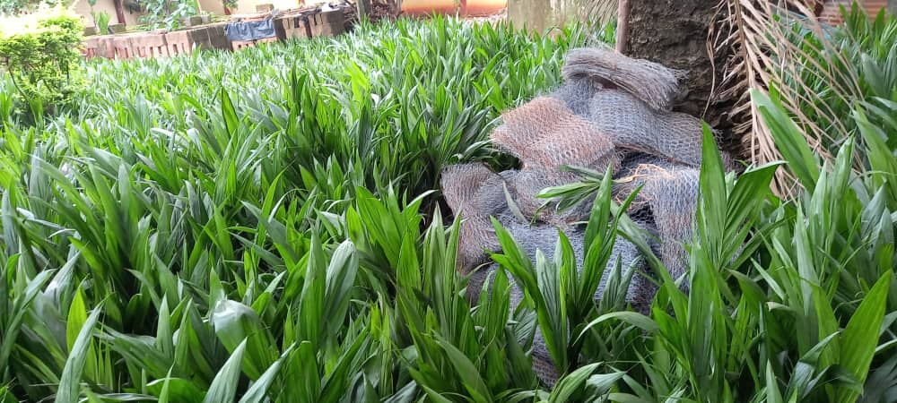

Slide 43
Policy Outcome Indicators and Targets
Outcome Indicator Description | Unit of Measurement | Baseline (2019) |  | Previous year’s performance (2020) |  | Current year’s Actual Performance (2021)
 |  | Target | Actual | Target | Actual | Target | Actuals as at July
Increased number of educational infrastructure | Number of classrooms | 624 | 624 | 633 | 633 | 639 | 633
 | Number of classroom blocks | 245 | 245 | 247 | 247 | 249 | 247
 | Number of Desk Provided | 350 | 350 | 400 | 350 | 400 | 0
Upgraded market infrastructure | Number of market facilities upgraded | 2 | 1 | 1 | 1 | 1 | 1

Slide 44
Policy Outcome Indicators and Targets. Cont…
Outcome Indicator Description | Unit of Measurement | Baseline (2019) |  | Previous year’s performance (2020) |  | Current year’s Actual Performance (2021)
 |  | Target | Actual | Target | Actual | Target | Actuals as at July
Improvement in business development skills | Number of business/skills development trainings organised | 20 | 10 | 20 | 15 | 20 | 15
Increased access to health infrastructure | Number of health facilities provided | 5 | 4 | 6 | 5 | 1 | 0
Economic empowerment of PWDs | No of PWDs supported | 150 | 135 | 150 | 145 | 160 | 130
Alleviate extreme poverty | Number of persons supported | 300 | 275 | 400 | 380 | 450 | 300

Slide 45
Policy Outcome Indicators and Targets. Cont….
Outcome Indicator Description | Unit of Measurement | Baseline (2019) |  | Previous year’s performance (2020) |  | Current year’s Actual Performance (2021)
 |  | Target | Actual | Target | Actual | Target | Actuals as at July
Increased stakeholders participation | Number of stakeholders meetings organised | 4 | 4 | 4 | 4 | 4 | 2
National Digital addressing system of AACMA | Number of street and properties named and numbered | 50 | 40 | 50 | 122
Expansion and Renovation of educational infrastructure | No of classroom blocks constructed | 5 | 5 | 5 | 3 | 5 | 2
Expansion of Health facilities | No. of health facilities constructed | 2 | 0 | 1 | 1 | 2 | 1

Slide 46
Policy Outcome Indicators and Targets. Cont….
Outcome Indicator Description | Unit of Measurement | Baseline (2019) |  | Previous year’s performance (2020) |  | Current year’s Actual Performance (2021)
 |  | Target | Actual | Target | Actual | Target | Actuals as at July
Composite Budget prepared based on Composite Annual Action Plan | Composite Budget approved by General Assembly by | 31ST Oct. | 31ST Oct. | 31ST Oct. | 31ST Oct. | 31ST Oct. | 0
Maintenance of Public Buildings | No of Staff Bungalows Renovated | 10 | 5 | 5 | 2 | 3 | 2
Rehabilitation of roads | Km of roads rehabilitated | 14KM | 14KM | 20KM | 20KM | 20KM | 20KM

Slide 47
Policy Outcome Indicators and Targets. Cont…
Outcome Indicator Description | Unit of Measurement | Baseline (2019) |  | Previous year’s performance (2020) |  | Current year’s Actual Performance (2021)
 |  | Target | Actual | Target | Actual | Target | Actuals as at July
Increase access to potable water | No. of boreholes drilled and mechanized | 5 | 4 | 10 | 4 | 6 | 5
Disaster Prevention and Management | No of Disaster Prevention Education organized | 4 | 4 | 4 | 2 | 4 | 2

Slide 48
KEY PERFORMANCE INFORMATION FOR BUDGET PROGRAMMES
( Management and Administration)
Key/Main Outputs | Output Indicator | Past Years
 |  | 2020 Target | 2020 Actual | 2021 Target | 2021 Actual as at July
Increase stakeholders participation | Number of stakeholders meetings organised | 4 | 4 | 4 | 2
Composite Budget prepared based on Composite Annual Action Plan | Composite Budget approved by General Assembly by | 31ST October | 31ST October | 31ST October | 0

Slide 49
KEY PERFORMANCE INFORMATION FOR BUDGET PROGRAMMES. Cont…
( Infrastructure Delivery and Management)
Key/Main Outputs | Output Indicator | Past Years
 |  | 2020 Target | 2020 Actual | 2021 Target | 2021 Actual as at July
Maintenance of Public Buildings | No of Staff Bungalows Renovated | 10 | 5 | 5 | 2
Expansion and Renovation of educational infrastructure | No of classroom blocks constructed | 5 | 2 | 3 | 2
Rehabilitation of roads | Km of roads rehabilitated | 14KM | 14KM | 20KM | 20KM

Slide 50
KEY PERFORMANCE INFORMATION FOR BUDGET PROGRAMMES. Cont……
( Social Service Delivery)
Key/Main Outputs | Output Indicator | Past Years
 |  | 2020 Target | 2020 Actual | 2021 Target | 2021 Actual as at July
Expansion of Health facilities | No. of health facilities constructed | 2 | 0 | 1 | 1
Increase access to potable water | No. of boreholes drilled and mechanized | 5 | 4 | 13 | 13

Slide 51
KEY PERFORMANCE INFORMATION FOR BUDGET PROGRAMMES. Cont….
( Environmental Management)
Key/Main Outputs | Output Indicator | Past Years
 |  | 2020 Target | 2020 Actual | 2021 Target | 2021 Actual as at July
Disaster Prevention and Management | No of Disaster Prevention Education organized | 4 | 4 | 4 | 4
Improvement in business development skills | Number of business/skills development trainings organised | 20 | 10 | 20 | 15

Slide 52
2021 BUDGET PROGRAMME PERFORMANCE
Name of Budget Programme | Budget | Actual as at July, 2021
Management and Administration | 5,362,046.00 | 1,559,434.44
Social Service Delivery | 3,491,439.00 | 589,862.03
Infrastructural Delivery and Management | 3,764,519.00 | 569,902.20
Economic Development | 1,063,148.25 | 425,763.78
Environmental management | 387,448.91 | 104,951.46
TOTAL | 14,068,601.16 | 3,249,913.91

Slide 53
2021 KEY PROJECTS AND PROGRAMMES FROM ALL SOURCES
NO | Name of Project | Amount Budgeted | Actual as at July, 2021 | Outstanding Payment
1 | Drilling and mechanization of 4 no. borehole at Odumasi market, Konongo market, Konongo lorry station, Kyekyeware | 165,000.00 | 112,989.60 | 52,010.40
2 | construction of 1no 10 seater squat W/C toilet with mechanised borehole at Agyareago | 184,531.00 | 148,043.70 | 36,487.30
3 | construction of 1no 10 seater squat W/C toilet with mechanised borehole at Kramokrom | 187,736.00 | 155,250.90 | 32,485.10
4 | construction of 1no 10 seater squat W/C toilet with mechanized borehole at Praaso | 185,733.00 | 161695.80 | 24,037.20

Slide 54
2021 KEY PROJECTS AND PROGRAMMES FROM ALL SOURCES cont.
NO | Name of Project | Amount Budgeted | Actual as at July, 2021 | Outstanding Payment
5. | Drilling and mechanization of No.borehole at Odumasi Extension, Dwease, Bimma, Patriensa, Adumkrom and Obenimase | 239,274.00 | 35,891.10 | 203,382.90
6. | Construction of 1 No 3 Unit Classroom Block, Ancilliary Facilities at Ohenekwanta | 383,882.00 | 272,678.47 | 111,203.53
7. | Renovation of Municipal Assembly Office Building | 199,981.00 | 102,811.15 | 97,169.85
 | TOTAL | 1,546,137.00 | 989,360.72 | 556,776.28

Slide 55
Sanitation Budget Performance
 | SOLID WASTE
No | Name of Activity/Project | Budget | Actual as at July, 2021
1 | Waste Management (Local) | 46,000.00 | 32,765.90
2 | Fumigation | 307,191.00 | 16,000.00
3 | Sanitation Improvement | 230,000.00 | 57,500.00
LIQUID WASTE
No | Name of Activity/Project | Budget | Actual as at July, 2021
1 | Dislodgement of Toilet | 30,000.00 | 17,879.70

Slide 56
DP Supported Programmes
No | Name of Activity/Project | Budget | Actual as at July, 2020
1 | MAG (DCAT - furnishing of office and meetings, licenses of motor bikes, allowances) | 102,000.00 | 48,039.20

Slide 57
Government Flagship Projects/Programmes
(Assembly’s Contribution)
No | Type of Flagship project/program | Name of Activity/Project | Budget | Actual as at July, 2021
1 | One District One Factory | Support for Construction of a cassava factory located at Low Cost – konongo (IDIF) (Facilitation of Land acquisition and Provision 1No. 50KVA pole-mounted transformer for the cassava factory at Konongo - Low cost) | 100,000.00 | 89,608.00
2 | Planting for Food and Jobs(PFJ) | Support to Planting for Food and Jobs(PFJ) (Facilitation of Land acquisition) | 50,000.00 | 25,800.00
3 | One District One Factory | Support for Construction of Rider Steel Factory (IDIF) at Odumasi three lane (Facilitation of Land acquisition) | 40,000.00 | 25,765.00

Slide 58
Government Flagship Projects/Programmes
(Assembly’s Contribution)
No | Type of Flagship project/program | Name of Activity/Project | Budget | Actual as at July, 2021
4 | Planting for Food and Jobs(PFJ) | Planting for export and rural development PERD (seedling of palm oil seedlings) | 165,000.00 | 100,000.00
5 | Planting for Food and Jobs(PFJ) | Support for Special Rice Initiative Programme | 10,000.00 | 6,567.98
6 | Support for free basic and SHS | Support for free basic and SHS ( provision of motor bikes, Monitoring, dual Desks) | 125,000.00 | 95,876.99

Slide 59
OUTLOOK FOR 2022-2025

Slide 60
MMDA Adopted Policy Objectives for 2022
FOCUS AREA | POLICY OBJECTIVE | BUDGET ALLOCATION
ADMINISTRATION | Deepen political and administrative decentralization | 4,052,373.08
EDUCATION & YOUTH DEVT | Ensure free, equitable and quality education for all by 2030 | 2,001,905.88
INFRASTRUTURE DELIVERY & MGT | i. Facilitate sustained and resilient infrastructure dev. ii. Enhance inclusive urbanization & capacity for settlement planning | 4,026,644.45
HEALTH | Achieve universal health coverage, including financial risk protection access to qual. health-care service | 1,311,642.15

Slide 61
MMDA Adopted Policy Objectives for 2022. cont…..
FOCUS AREA | POLICY OBJECTIVE | BUDGET ALLOCATION
TOURISM, TRADE & INDUSTRY, | Ensure all learners acquire know. & skills, to promote Sustainable development | 1,014,192.13
SOC. WEL. & COM.DEVT | Implement appropriate social protection system and measures | 450,000.00
AGRICULTURE | Improve production efficiency and yield | 443,742.76
TOTAL |  | 13,300,500.45

Slide 62
POLICY OUTCOME INDICATORS AND TARGETS
Outcome Indicator Description | Unit of Measurement | Baseline 2019 |  | Previous year 2020 |  | Current Year (2021) |  | Indicative year (2022) | Indicative year (2023) | Indicative year (2024) | Indicative year (2025)
 |  | Year | Value | Year 2020 | Value | Target | Actual as at July | Target | Target | Target | Target
Increase in the number of educational infrastructure | Number of classrooms | 630 | 624 | 635 | 628 | 670 | 0 | 682 | 694 | 706 | 718
 | Number of Desk Provided | 400 | 350 | 450 | 450 | 800 | 0 | 900 | 1000 | 1100 | 1200
Increase access to health infrastructure | Number of health facilities provided | 5 | 4 | 7 | 3 | 2 | 1 | 3 | 4 | 5 | 6

Slide 63
POLICY OUTCOME INDICATORS AND TARGETS. Cont…..
Outcome Indicator Description | Unit of Measurement | Baseline 2019 |  | Previous year 2020 |  | Current Year (2021) |  | Indicative year (2022) | Indicative year (2023) | Indicative year (2024) | Indicative year (2025)
 |  | Year | Value | Year 2020 | Value | Target | Actual as at July | Target | Target | Target | Target
Upgrade market infrastructure | Number of market facilities upgraded | 1 | 1 | 1 | 1 | 1 | 0 | 2 | 2 | 2 | 2
Improvement in business development skills | Number of business/skills development trainings organised | 20 | 10 | 20 | 15 | 40 | 12 | 15 | 20 | 25 | 30

Slide 64
POLICY OUTCOME INDICATORS AND TARGETS. Cont……
Outcome Indicator Description | Unit of Measurement | Baseline 2019 |  | Previous year 2020 |  | Current Year (2021) |  | Indicative year (2022) | Indicative year (2023) | Indicative year (2024) | Indicative year (2025)
 |  | Year | Value | Year 2020 | Value | Target | Actual as at July | Target | Target | Target | Target
Increase stakeholders participation | Number of stakeholders meetings organised | 4 | 4 | 4 | 2 | 4/yr | 0 | 4 | 4 | 4 | 4
Build capacity of land owners and chiefs on settlement planning | Number of development application processed | 120 | 95 | 130 | 125 | 140/yr | 0 | 150 | 200 | 250 | 300
Child right and family welfare promoted | No of cases resolved | 150 | 134 | 250 | 100 | 152 | 0 | 155 | 160 | 165 | 170

Slide 65
POLICY OUTCOME INDICATORS AND TARGETS. Cont…..
Outcome Indicator Description | Unit of Measurement | Baseline 2019 |  | Previous year 2020 |  | Current Year (2021) |  | Indicative year (2022) | Indicative year (2023) | Indicative year (2024) | Indicative year (2025)
 |  | Year | Value | Year 2020 | Value | Target | Actual as at July | Target | Target | Target | Target
National Digital addressing or AACMA | Number of street and properties named and numbered | 30 | 20 | 70 | 55 | 350 | 0 | 355 | 360 | 365 | 370
Economic empowerment of PWDs | No of PWDs supported | 200 | 145 | 120 | 67 | 120 | 0 | 130 | 130 | 130 | 130
Alleviate extreme poverty | Number of persons supported | 320 | 275 | 510 | 402 | 500 | 0 | 500 | 500 | 500 | 500

Slide 66
EXPENDITURE BY BUDGET PROGRAMME AND ECONOMIC CLASSIFICATION – ALL FUNDING SOURCES
BUDGET PROGRAMME | COMPENSATION OF EMPLOYEES | AMOUNT GH¢
 |  | GOODS & SERVICE | CAPITAL INVESTMENT | TOTAL
Management and Administration | 1,932,422.73 | 2,829,573.12 | 758,765.00 | 5,520,760.85
Social Service Delivery | 263,456.47 | 757,127.20 | 1,189,301.34 | 2,209,885.01
Infrastructural Delivery and Management | 283,910.27 | 1,206,480.31 | 2,468,079.34 | 3,958,469.92
Economic Development | 380,156.88 | 548,501.89 | 0 | 928,658.77
Environmental management | 232,725.90 | 450,000.00 | 0 | 682,725.90
TOTAL | 3,375,743.00 | 5,508,611.77 | 4,416,145.68 | 13,300,500.45

Slide 67
KEY PERFORMANCE INFORMATION FOR BUDGET PROGRAMMES
Key/Main Outputs | Output Indicator | Past Years |  |  |  | Projections
 |  | 2020 Target | 2020 Actual | 2021 Target | 2021 Actual | Budget Year | Indicative Year | Indicative Year | Indicative Year
 |  |  |  |  |  | 2022 | 2023 | 2024 | 2025
Expansion and Renovation of educational infrastructure | No of classroom blocks constructed | 5 | 5 | 5 | 3 | 3 | 3 | 3 | 3
Expansion of Health facilities | No. of health facilities constructed | 2 | 0 | 1 | 1 | 2 | 2 | 2 | 2

Slide 68
KEY PERFORMANCE INFORMATION FOR BUDGET PROGRAMMES cont….
Key/Main Outputs | Output Indicator | Past Years |  |  |  | Projections
 |  | 2020 Target | 2020 Actual | 2021 Target | 2021 Actual | Budget Year | Indicative Year | Indicative Year | Indicative Year
 |  |  |  |  |  | 2022 | 2023 | 2024 | 2025
Composite Budget prepared based on Composite Annual Action Plan | Composite Budget approved by General Assembly by | 31ST October | 31ST October | 31ST October | 0 | 31ST October | 31ST October | 31ST October | 31ST October

Slide 69
KEY PERFORMANCE INFORMATION FOR BUDGET PROGRAMMES. Cont…
Key/Main Outputs | Output Indicator | Past Years |  |  |  | Projections
 |  | 2020 Target | 2020 Actual | 2021 Target | 2021 Actual | Budget Year | Indicative Year | Indicative Year | Indicative Year
 |  |  |  |  |  | 2022 | 2023 | 2024 | 2025
Maintenance of Public Buildings | No of Staff Bungalows Renovated | 10 | 5 | 5 | 2 | 10 | 13 | 16 | 17
Rehabilitation of roads | Km of roads rehabilitated | 14KM | 14KM | 20KM | 20KM | 20KM | 20KM | 20KM | 20KM
Increase access to potable water | No. of boreholes drilled and mechanized | 5 | 4 | 13 | 13 | 10 | 10 | 10 | 10

Slide 70
KEY PERFORMANCE INFORMATION FOR BUDGET PROGRAMMES. Cont…
Key/Main Outputs | Output Indicator | Past Years |  |  |  | Projections
 |  | 2020 Target | 2020 Actual | 2021 Target | 2021 Actual | Budget Year | Indicative Year | Indicative Year | Indicative Year
 |  |  |  |  |  | 2022 | 2023 | 2024 | 2025
Expansion of Health facilities | No. of health facilities constructed | 2 | 0 | 1 | 1 | 2 | 2 | 2 | 2
Disaster Prevention and Management | No of Disaster Prevention Education organized | 4 | 4 | 4 | 4 | 4 | 4 | 4 | 4

Slide 71
2022 EXPENDITURE BY BUDGET PROGRAMME, PROJECTS AND ECONOMIC CLASSIFICATION
BUDGET PROGRAMME | KEY PRIORITY PROJECT/ACTIVITY FOR 2022 | AMOUNT GH¢
 |  | GOODS & SERVICE | CAPITAL INVESTMENT | TOTAL
Management and Administration | Support to Municipal Sub-structure | 82,127.20 |  | 82,127.20
 | Public Fora | 100,000.00 |  | 100,000.00
 | Revision of Medium Term dev’t plan and Composite Budget | 80,000.00 |  | 80,000.00
 | Public Education on Revenue mobilization | 30,000.00 |  | 30,000.00

Slide 72
2022 EXPENDITURE BY BUDGET PROGRAMME, PROJECTS AND ECONOMIC CLASSIFICATION. Cont….
BUDGET PROGRAMME | KEY PRIORITY PROJECT FOR 2022 | AMOUNT GH¢
 |  | GOODS & SERVICE | CAPITAL INVESTMENT | TOTAL
SOCIAL SERVICES AND DELIVERY | Construction of No.1, 3 Unit Block with Ancillary Facility at Ohenenkwanta |  | 393,000.00 | 393,000.00
 | Provision of Educational Furniture |  | 100,0000.00 | 100,0000.00
 | Municipal Education fund | 82,127.20 |  | 82,127.20
 | Construction of School Buildings |  | 601,499.34 | 601,499.34

Slide 73
2022 EXPENDITURE BY BUDGET PROGRAMME, PROJECTS AND ECONOMIC CLASSIFICATION . Cont….
BUDGET PROGRAMME | KEY PRIORITY PROJECT FOR 2022 | AMOUNT GH¢
 |  | GOODS & SERVICE | CAPITAL INVESTMENT | TOTAL
SOCIAL SERVICES DELIVERY | Provision of CHPs Compound at Annuruso Bye Water |  | 240,000.00 | 240,000.00
 | Construction and Mechanization of 4 No Boreholes |  | 151,000.00 | 151,000.00
 | Support to Income Generating activities for PWDs | 92,393.10 |  | 92,393.10

Slide 74
2022 EXPENDITURE BY BUDGET PROGRAMME, PROJECTS AND ECONOMIC CLASSIFICATION. Cont…
BUDGET PROGRAMME | KEY PRIORITY PROJECT FOR 2022 | AMOUNT GH¢
 |  | GOODS & SERVICE | CAPITAL INVESTMENT | TOTAL
ECONOMIC DEVELOPMENT | Implementation of one district one factory | 100,000.00 |  | 100,000.00
 | Implementation of planting for food and jobs | 100,000.00 |  | 100,000.00
 | Support to Business Advisory Centre/Rural Technology facility | 20,000.00 |  | 20,000.00
ECONOMIC MANAGEMENT | Disaster prevention and management | 100,000.00 |  | 100,000.00

Slide 75
2022 EXPENDITURE BY BUDGET PROGRAMME, PROJECTS AND ECONOMIC CLASSIFICATION. Cont….
BUDGET PROGRAMME | KEY PRIORITY PROJECT FOR 2022 | AMOUNT GH¢
 |  | GOODS & SERVICE | CAPITAL INVESTMENT | TOTAL
INFRASTRUCTURE DEVELOPMENT AND MANAGEMENT | Renovation of Assembly Properties |  | 275,024.54 | 275,024.54
 | Procurement of items for self help community project | 205,318.01 |  | 205,318.01
 | Procurement of Electricity poles and Accessories |  | 100,000.00 | 100,000.00
TOTAL |  | 5,508,611.77 | 4,416,145.68 | 9,924,757.45

Slide 76
2022-2025 REVENUE PROJECTIONS – IGF ONLY
ITEM | 2021 |  | 2022 | 2023 | 2024 | 2025
 | Budget | Actual as at August | Projection | Projection | Projection | Projection
Basic Rate | 3,000.00 | 1,399.00 | 3,000.00 | 3,500.00 | 4,000.00 | 4,500.00
Property Rate | 292,465.74 | 78,409.87 | 292,465.00 | 293,075.73 | 294,241.03 | 295,341.13
Fees | 567,500.00 | 177,871.00 | 584,500.00 | 585,700.00 | 586,800.00 | 587,900.00
Fines | 29,440.00 | 7,150.00 | 29,440.00 | 29,540.00 | 30,089.07 | 30,191.28
License | 315,675.00 | 98,096.00 | 306,643.00 | 308,775.00 | 308,974.31 | 309,074.41
Land | 163,600 | 112,962.00 | 173,600.00 | 174,270.00 | 175,831.28 | 176,931.42
Stool Lands | 20,000.00 | 11,800.00 | 30,000.00 | 30,000.00 | 30,000.00 | 30,000.00
Rent | 77,870.00 | 48,456.00 | 82,352.00 | 82,452.00 | 82,552.00 | 82,652.00
Miscellaneous | 500 | 0 | 0 | 0.00 | 0.00 | 0.00
Total | 1,470,050.74 | 536,143.87 | 1,502,000.00 | 1,507,312.73 | 1,512,487.69 | 1,516,590.24

Slide 77
Government Flagship Projects/Programmes
(Assembly’s Support)
No | Type of Flagship project/program | Name of Activity/Project | Budget | Funding Source
1 | One District One Factory | Facilitation of Land acquisition. Provision 1No. 50KVA pole-mounted transformer for the cassava factory at Konongo - Low cost | 89,608.00 | DACF/IGF
2 | Planting for Food and Jobs(PFJ) | Facilitation of Land acquisition Public sensitization and distribution of inputs for selected women groups Special rice initiative; | 30,000.00 | DACF/IGF
3 | One District One Factory | Construction of Rider Steel Factory (IDIF) at Odumasi three lane (Facilitation of Land acquisition) | 30,000.00 | DACF/IGF
4 | Planting for export and rural development PERD | Distribution of 10,000 oil palm seedlings | 100,000.0 | DACF/IGF
5 | Support for Special Rice Initiative Programme | Distribution of rice inputs to women groups | 10,000.00 | DACF/IGF
6 | Support for free basic and SHS | Provision of motor bikes, Monitoring, dual Desks | 200,000.00 | DACF/IGF

Slide 78
2022-2025 Expenditure Projections by Economic Classification- All Funding Sources
Expenditure Items | 2021 Budget | Actual as at July, 2021 | 2022 | 2023 | 2024 | 2025
COMPENSATION | 3,496,352.99 | 1,375,623.10 | 3,375,743.00 | 4,247,305.86 | 4,259,671.16 | 4,260,154.71
GOODS AND SERVICE | 5,687,848.19 | 532,989.58 | 5,508,611.77 | 6,235,566.58 | 6,247,344.91 | 6,372,212.16
ASSETS | 4,884,399.98 | 751,669.79 | 4,416,145.68 | 3,417,848.49 | 3,538,740.92 | 3,565,677.96
TOTAL | 14,068,601.16 | 2,660,282.47 | 13,300,500.45 | 13,900,720.93 | 14,045,756.99 | 14,198,044.83

Slide 79
SUMMARY OF EXPENDITURE BUDGET BY DEPARTMENT, ITEM AND FUNDING SOURCE-2022
 | Department | Compensation | Goods and services | Assets | Total | Funding (indicate amount against the funding source) |  |  |  |  | Total
 |  |  |  |  |  | Assembly’s IGF | GOG | DACF | DACF-RFG | OTHERS (MAG)
1 | Central Administration | 1,279,814.60 | 1,679,548.58 | 626,809.00 | 3,586,172.18 | 816,050.00 | 1,149,814.00 | 1,520,308.18 | 100,000 | 0 | 3,586,172.18
2 | Human Resource Management | 125,050.76 | 55,000.00 | 0 | 180,050.76 | 35,000.00 | 27,000.00 | 118,050.76 | 0 | 0 | 180,050.76
3 | Statistical Service | 20,200.00 | 80,000.00 | 0 | 100,200.00 | 35,000.00 | 27,000.00 | 38,200.00 | 0 | 0 | 100,200.00
4 | Works department | 443,572.46 | 356,535.70 | 1,170,549.24 | 1,970,657.40 | 254,522.69 | 489,147.70 | 1,226,987.01 | 0 | 0 | 1,970,657.40
5 | Department of Agriculture | 785,156.88 | 898,501.77 | 0 | 1,683,658.65 | 56,689.79 | 980,974.88 | 571,207.97 | 0 | 74,786.01 | 1,683,658.65
6 | Dept of Social Welfare and Com. DEV.T | 460,456.47 | 544,791.63 | 0 | 1,005,248.10 | 60,000.00 | 476,048.11 | 469,199.99 | 0 | 0 | 1,005,248.10

Slide 80
SUMMARY OF EXPENDITURE BUDGET BY DEPARTMENT, ITEM AND FUNDING SOURCE-2022
 | Department | Compensation | Goods and services | Assets | Total | Funding (indicate amount against the funding source) |  |  |  |  | Total
 |  |  |  |  |  | Assembly’s IGF | GOG | DACF | DACF-RFG | OTHERS (MAG)
7 | Urban Roads | 0 | 182,678.46 | 400,623.83 | 583,302.29 | 40,000.00 | 58,558.50 | 484,743.79 | 0 | 0 | 583,302.29
8 | Physical Planning | 74,016.69 | 167,676.87 | 150,000.00 | 391,693.56 | 53,002.87 | 99,081.81 | 239,608.88 | 0 | 0 | 391,693.56
9 | Trade and Industry | 0 | 150,000.00 | 0 | 150,000.00 | 32,000.00 | 0 | 118,00.00 | 0 | 0 | 150,000.00
10 | Finance | 0 | 91,000.00 | 0 | 91,000.00 | 40,000.00 | 0 | 51,000.00 | 0 | 0 | 91,000.00
11 | Education youth and sports | 0 | 376,127.02 | 856,213.51 | 1,232,340.53 | 34,000.00 | 0 | 556,374.93 | 641,965.60 | 0 | 1,232,340.53
12 | Disaster Prevention and Management | 0 | 350,000.00 | 0 | 350,000.00 | 50,000.00 | 0 | 300,000.00 | 0 | 0 | 350,000.00
13 | Health | 332,725.90 | 711,751.74 | 931,499.34 | 1,975,976.98 | 65,734.65 | 268,567.74 | 687,357.59 | 954,317.00 | 0 | 1,975,976.98
 | TOTALS | 3,520,993.76 | 5,643,611.77 | 4,135,694.92 | 13,300,300.45 | 1,572,000.00 | 3,576,192.74 | 6,263,039.10 | 1,696,282.60 | 74,786.01 | 13,300,300.45

Slide 81
PROJECTS/PROGRAMMES FOR 2022 AND CORRESPONDING COST AND JUSTIFICATION
SN | List Of Projects | IGF (GHc) | GOG (GHc) | DACF (GHc) | DDF (GHc) | UDG (GHc) | Other Donor (GHc) | Total Budget (GHc) | Justification- What do you intend to achieve with the programmes/projects and how does this link to your objectives?
 | Social Sector
1 | Construction of 1 No 3 unit classroom blocks, ancillary facilities at Ohenekwanta |  |  | 383,882.00 |  |  |  | 383,882.00 | To provide educational infrastructure and increase access and participation in education
2 | Municipal education fund (2%) |  |  | 82,127.20 |  |  |  | 82,127.20 | To provide educational infrastructure and increase access and participation in education
3 | Renovation of Existing classroom block in the municipality |  |  | 250,000.00 |  |  |  | 250,000.00 | To provide educational infrastructure and increase access and participation in education
4 | Construction of 6unit classroom block with ancillary facilities at Nsiakrom |  |  | 570,000.00 |  |  |  | 570,000.00 | To provide educational infrastructure and increase access and participation in education

Slide 82
PROJECTS/PROGRAMMES FOR 2022 AND CORRESPONDING COST AND JUSTIFICATION. CONT……
SN | List Of Projects | IGF (GHc) | GOG (GHc) | DACF (GHc) | DDF (GHc) | UDG (GHc) | Other Donor (GHc) | Total Budget (GHc) | Justification- What do you intend to achieve with the programmes/projects and how does this link to your objectives?
 | Social Sector
5 | Provision of educational furniture |  |  | 100,000.00 |  |  |  | 100,000.00 | To provide educational infrastructure and increase access and participation in education
6 | Construction of CHPs compounds Annuruso bye water |  |  | 240,000.00 |  |  |  | 240,000.00 | Strengthen efficiency and effectiveness in health service
7 | Support roll back malaria(0.5%) and HIV/AIDS |  |  | 82,127.20 |  |  |  | 82,127.20 | Strengthen efficiency and effectiveness in health service
8 | Public fora |  |  | 100,000.00 |  |  |  | 100,000.00 | To increase stakeholders participation in local governance
9 | Covid 19 related issues | 20,000 |  | 50,000 |  |  |  | 70,000.00 | Strengthen efficiency and effectiveness in health service

Slide 83
PROJECTS/PROGRAMMES FOR 2022 AND CORRESPONDING COST AND JUSTIFICATION. CONT……
 | List all Projects | IGF (GHc) | GOG (GHc) | DACF (GHc) | DDF (GHc) | UDG (GHc) | Other Donor (GHc) | Total Budget (GHc) | Justification- What do you intend to achieve with the programmes/projects and how does this link to your objectives?
 | Infrastructure
10 | Support to community self help project(5%) |  |  | 205,318.01 |  |  |  | 205,318.01 | To ensure effective service delivery through provision of equipment and tools
11 | Renovation of assembly properties |  |  | 250,000.00 |  |  |  | 100,000.00 | To house and equip staff to deliver their service
12 | Procurement of electricity poles and accessories |  |  | 200,000.00 |  |  |  | 100,000.00 | To provide adequate power to meet electricity needs
13 | Rehabilitation of roads in the municipality |  |  | 100,000.00 |  |  |  | 100,000.00 | To make the roads motorable for easy conveyance of goods
14 | Construction and mechanization of 4 No borehole |  |  |  | 151,000.00 |  |  | 151,000.00 | To provide portable water for these communities
15 | Construction and mechanization of 6 No borehole | 250,000.00 |  |  |  |  |  | 250,000.00 | To provide portable water for these communities

Slide 84
PROJECTS/PROGRAMMES FOR 2022 AND CORRESPONDING COST AND JUSTIFICATION. CONT…..
S/N | List all Projects | IGF (GHc) | GOG (GHc) | DACF (GHc) | DDF (GHc) | UDG (GHc) | Other Donor (GHc) | Total Budget (GHc) | Justification- What do you intend to achieve with the programmes/projects and how does this link to your objectives?
 | Economic
14 | Implementation of one district one factory |  |  | 100,000.00 |  |  |  | 100,000.00 | To promote commercial activities and improve revenue generation
15 | Support to business advisory centre/rural technology facility |  |  | 20000.00 |  |  |  | 20000.00 | To promote commercial activities and improve revenue generation
16 | Public education on revenue mobilization |  |  | 80,000.00 |  |  |  | 80,000.00 | Improve revenue generation
17 | Mechanised Agriculture (MAG) |  |  |  |  |  | 172,948.66 | 172,948.66 | Improve crop yield
18 | Support to Planting for food and jobs |  |  | 100,000.00 |  |  |  | 100,000.00 | Improve crop yield
19 | Internal management of the assembly | 452,675.90 |  |  |  |  |  | 452,675.90 | Strengthen efficiency and effectiveness of service delivery

Slide 85
PROJECTS/PROGRAMMES FOR 2022 AND CORRESPONDING COST AND JUSTIFICATION. CONT…..
S/N | List all Projects | IGF (GHc) | GOG (GHc) | DACF (GHc) | DDF (GHc) | UDG (GHc) | Other Donor (GHc) | Total Budget (GHc) | Justification- What do you intend to achieve with the programmes/projects and how does this link to your objectives?
20 | GOVERNANCE National day Celebrations |  |  | 100,000.00 |  |  |  | 100,000.00 | To provide support to National programmes
21 | Support to sub municipal structures (2%) |  |  | 82,127.20 |  |  |  | 82,127.20 | To strengthen sub-strutures to function efficiently.
22 | Support to security services |  |  | 300,00.00 |  |  |  | 300,00.00 | To provide safety and security
23 | Local training programmes | 40,000.00 |  | 40,000.00 | 34,615.389 |  |  | 114,615.89 | To boost the capacity of Staff and Assembly members
24 | Project management and support to MPCU and composite Budget preparation |  |  | 100,000.00 |  |  |  | 100,000.00 | To support planning and budgeting

Slide 86
SANITATION BUDGET
No. | Name of Activity/Project SOLID WASTE | Budget
1 | Construction of Toilet facilities at Dwease,Agyarago, Anurosu | 244,000.00
2 | Education on Environmental Sanitation | 46,000.00
3 | Fumigation | 284,000.00
4 | Refuse Collections & Disposal (Sanitation Improvement Package) | 230,000.00
 | LIQUID WASTE
1 | Dislodging of Office and Residential toilets | 50,000.00

Slide 87
DP Supported Programs (MAG)
No | Name of Activity/Project | Budget
1 | MAG (DCAT - furnishing of office and meetings, licenses of motor bikes, allowances) | 74,786.01

Slide 88
COMPENSATION OF EMPLOYEES - 2022
N0. | DEPARTMENT | STAFF STRENGTH
 |  | GOG | IGF | 2021 RETIREES
1 | CENTRAL ADMINISTRATION | 34 | 11 | 0
2 | WORKS | 9 | 5 | 1
3 | PHYSICAL PLANNING | 5 | 0 | 0
4 | SOCIAL WELFARE & COM. DEVT | 6 | 0 | 0
5 | ENVIRONMENTAL HEALTH | 22 | 9 | 2
6 | AGRIC | 16 | 0 | 0
7 | FINANCE (REVENUE) | 13 | 0 | 0
 | TOTAL NUMBER OF STAFF | 105 | 25 | 3
 | TOTAL AMOUNT BUDGETED FOR 2022 | 3,375,743.00

Slide 89
IGF-COMPENSATION
S/N | NAME | GRADE | MONTHLY SALARY | ANNUAL SALARY
1 | Abugri Kusasi | Refuse Labourer | 287.5 | 3,450.00
2 | Sebastian Aduko | Night watchman | 329.6 | 3,955.20
3 | John Laar | Night watchman | 323.6 | 3,883.20
4 | Musah Manprusi | Night watchman | 329.6 | 3,883.20
5 | Moro Ayirekah | Night watchman | 329.6 | 3,883.20
6 | Yaw Ben | Night watchman | 329.6 | 3,883.20
7 | Ampofo Grace | Typist Grade 1 | 329.6 | 3,883.20
8 | Owusu Ibrahim | Machanic | 460.9 | 5,530.80
9 | Abigail Owusu | Cook | 298.70 | 3584.40
10 | Esther Boakye | cleaner | 287.5 | 3,450.00
11 | Mamudu Alhassan | Refuse Labourer | 287.5 | 3,450.00
12 | Victor Anafo | Refuse Labourer | 287.5 | 3,450.00
13 | Baba Grusi | Refuse Labourer | 287.5 | 3,450.00

Slide 90
IGF-COMPENSATION cont……
S/N | NAME | GRADE | MONTHLY SALARY | ANNUAL SALARY
14 | Nasiru Abulai | Night watchman | 322.1 | 3,865.20
15 | Nyarko Ernest | welder/fabricator | 338.7 | 4,064.40
16 | Adwoa Ataa | cleaner | 298.7 | 3,584.40
17 | Vivian Owusu Banahene | cleaner | 298.7 | 3,584.40
18 | Abubakar Sadiq | Watchman | 298.70 | 3584.40
19 | Kwaku Frimpong | Watchman | 298.70 | 3584.40
20 | Osei Francisca | cleaner | 313.7 | 3,764.40
21 | Peter Akomisah | Labourer | 313,70 | 3,764.40
22 | Moro Abdulai | Night watchman | 298.7 | 3,584.40
23 | Richard Adu-Obeng | Store keeper | 500.00 | 6,000.00
24 | Vincent Sackey | Ass. Dev’t Planning officer | 500.00 | 6,000.00
25 | Joyce Obeng | House Cleaner | 299.70 | 3596.40
 |  |  | 8,234.10 | 98,713.20

Slide 91
RETIREES
S/N | NAME | STAFF ID | CURRENT GRADE | MONTHLY BASIC SALARY | DATE OF APPOINTMENT | DATE OF RETIREMENT
1 | Stephen Obeng | 33151 | Yard Foreman | 2,044.54 | 1st Sept, 1985 | 15th March, 2022
2 | Opoku Boahen | 104678 | Transport Officer | 1,786.61 | 1st Jan, 1996 | 4th August, 2022
3 | Kennedy Adjabeng | 110583 | Accounts technician | 1,342.78 | 1st July, 1995 | 27th March, 2022
4 | Felix Abaka-Quansah | 22398 | Chief Tech Engineer | 3,390.20 | 1st Sept, 1991 | 15th May, 2022
5 | Braimah Issifu | 65643 | Watcman | 865.42 | 1st Sept, 1982 | 1st Sept, 1982

Slide 92

Thank You
End of Presentation

